Slide 1
Chapter 10
8051 SERIAL COMMUNICATION

Slide 2
Outlines
Contrast and compare serial versus parallel communication
List the advantages of serial communication over parallel
Explain serial communication protocol
Contrast synchronous versus asynchronous communication
Contrast half-versus full-duplex transmission

Slide 3
Explain the process of data framing
Describe data transfer rate and bps rate
Define the RS232 standard
Explain the use of the MAX232 and MAX233 chips
Interface the 8051 with an RS232 connector
Discuss the baud rate of the 8051
Describe serial communication features of the 8051
Program the 8051 for serial data communication

Slide 4
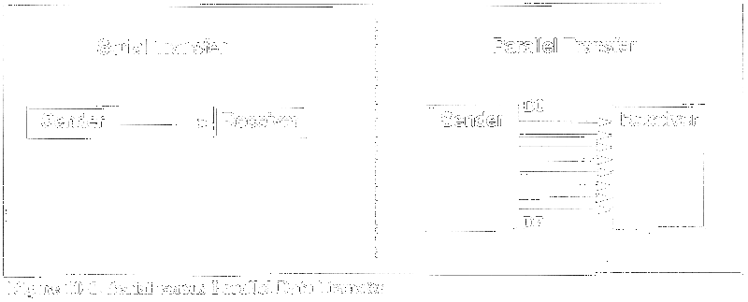
Basics of serial communication

Slide 5
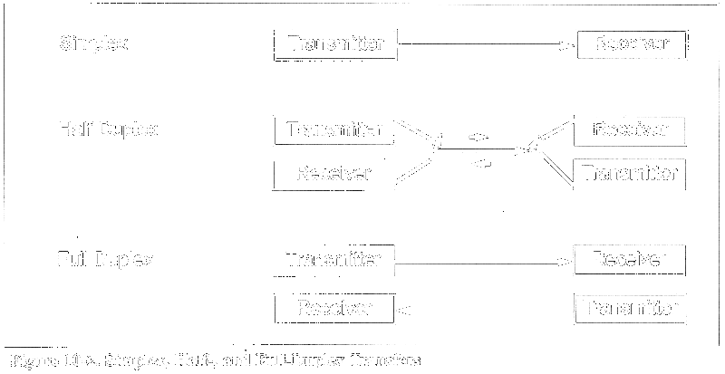

Slide 6
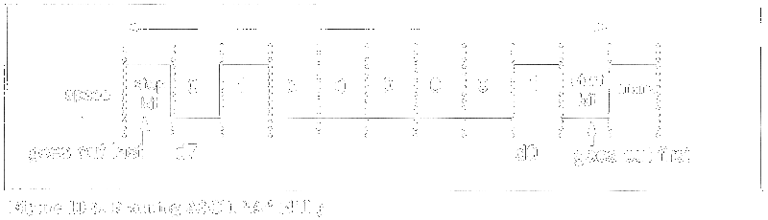
Start and stop bits

Slide 7
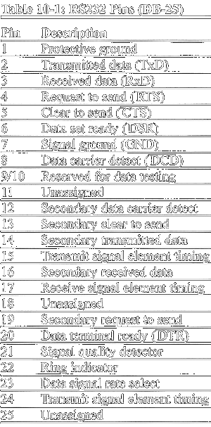
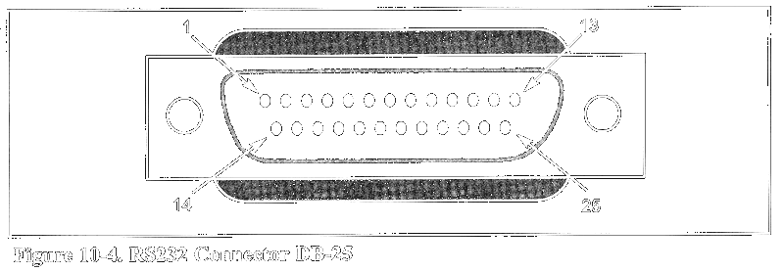
RS232 pins

Slide 8
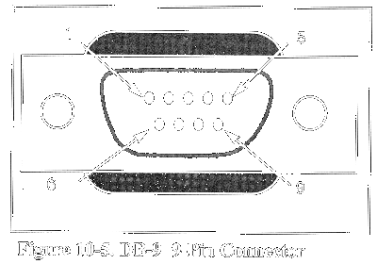
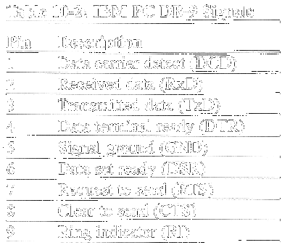
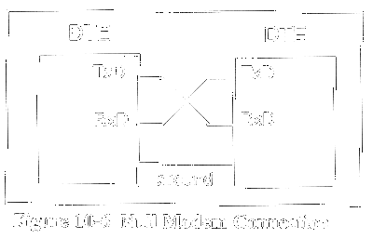
Data communication classification

Slide 9
RxD and TxD pins in the 8051
TxD pin 11 of the 8051 (P3.1)
RxD pin 10 of the 8051 (P3.0)

Slide 10
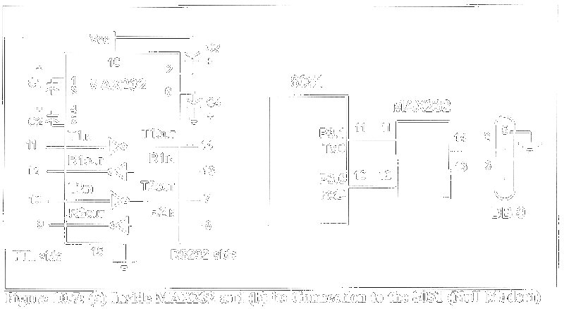
MAX232

Slide 11
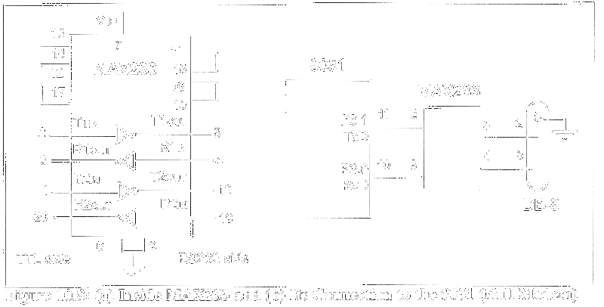
MAX233

Slide 12
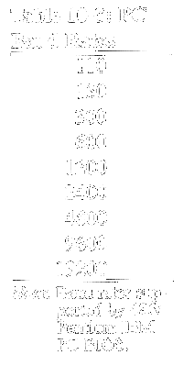
8051 SERIAL COMMUNICATION PROGRAMMING

Slide 13
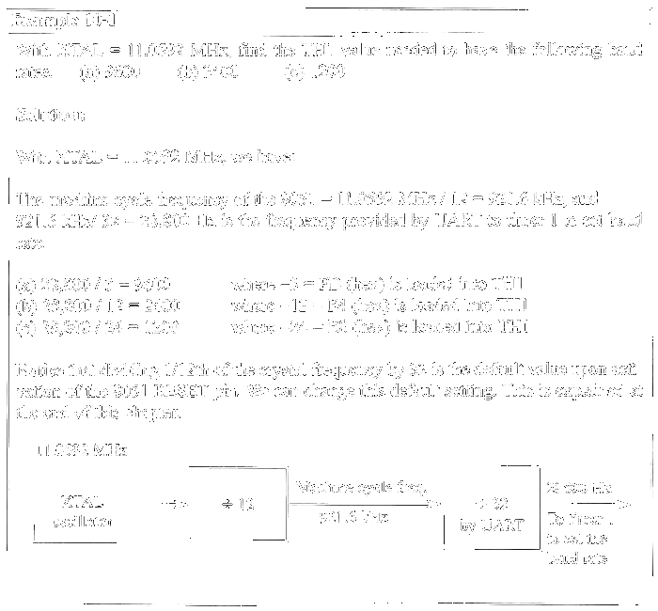

Slide 14
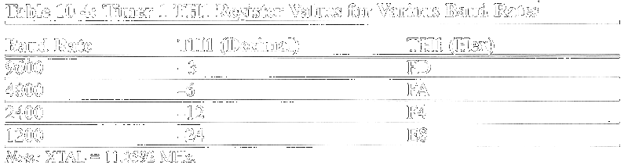

Slide 15
SBUF register
MOV SBUF,#’D’ ;load SBUF=44H, ASCII for ‘D’
MOV SBUF,A ;copy accumulator into SBUF
MOV A,SBUF ;copy SBUF into accumulator

Slide 16
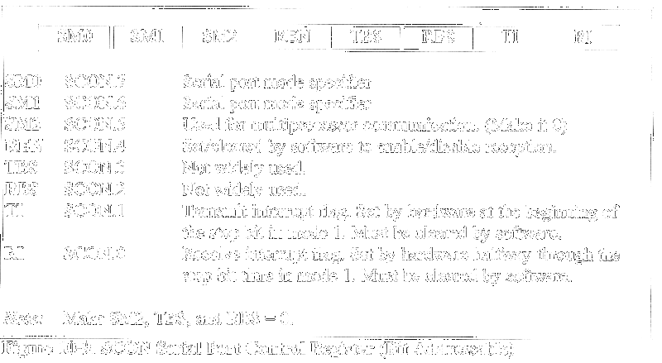
SCON (Serial control) register

Slide 17
SM0,SM1
SM0 and SM1 are D7 and D6 of the SCON
SM0 SM1
0 0 Serial Mode 0
0 1 Serial Mode 1,8 bit data,
1 stop bit, 1 start bit
1 0 Serial Mode 2
1 1 Serial Mode 3

Slide 18
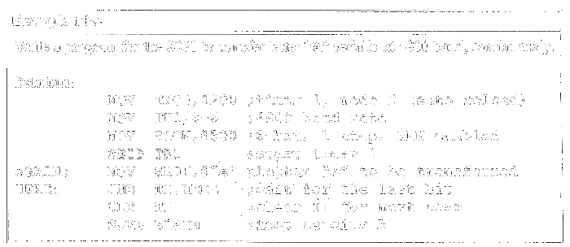
Programming the 8051 to transfer data serially

Slide 19
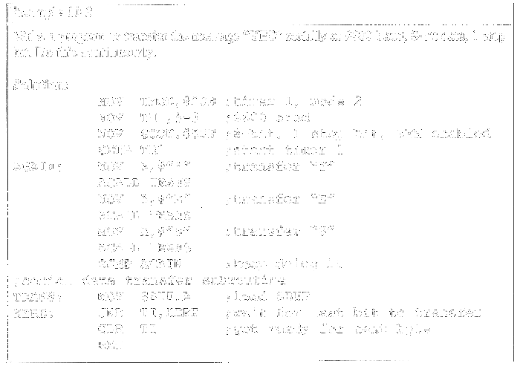

Slide 20
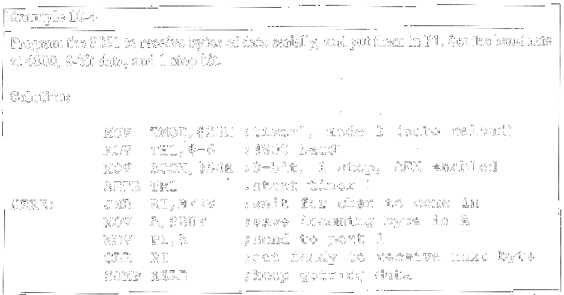
Programming the 8051 to receive data serially

Slide 21
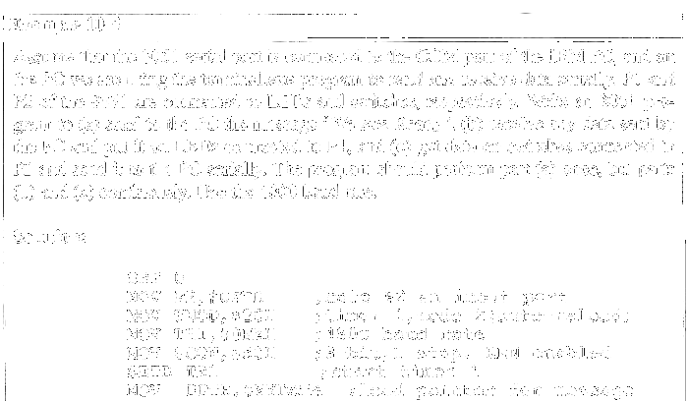

Slide 22
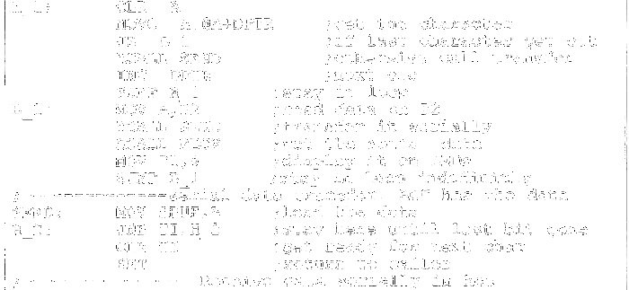

Slide 23
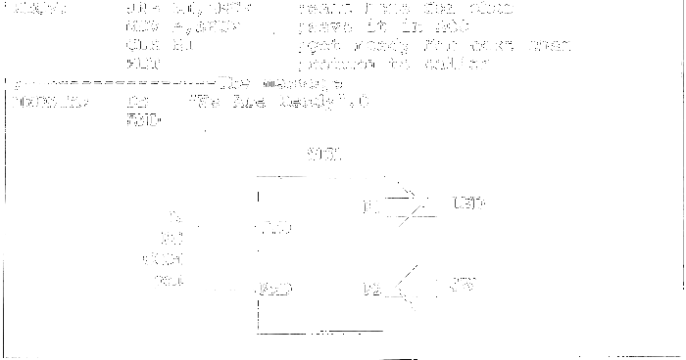

Slide 24
Doubling the baud rate in the 8051
To use a higher frequency crystal
To change a bit in the PCON register
D7
D0
SMOD | -- | -- | -- | GF1 | GF0 | PD | IDL
MOV A,PCON ;place a copy of PCON in ACC
SETB ACC.7 ;make D7=1
MOV PCON,A ;now SMOD=1 without
;changing any other bits

Slide 25
Baud rates for SMOD=0
Machine cycle freq. = 11.0592 MHz / 12 = 921.6 kHz
and
921.6 kHz / 32 = 28,800 Hz since SMOD = 0

Slide 26
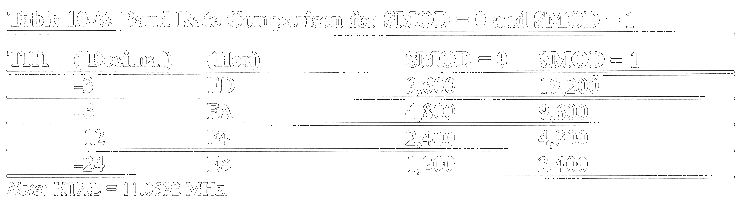
Baud rates for SMOD=1
Machine cycle freq. = 11.0592 MHz / 12 = 921.6 kHz
and
921.6 kHz / 16 = 57,600 Hz since SMOD = 1

Slide 27
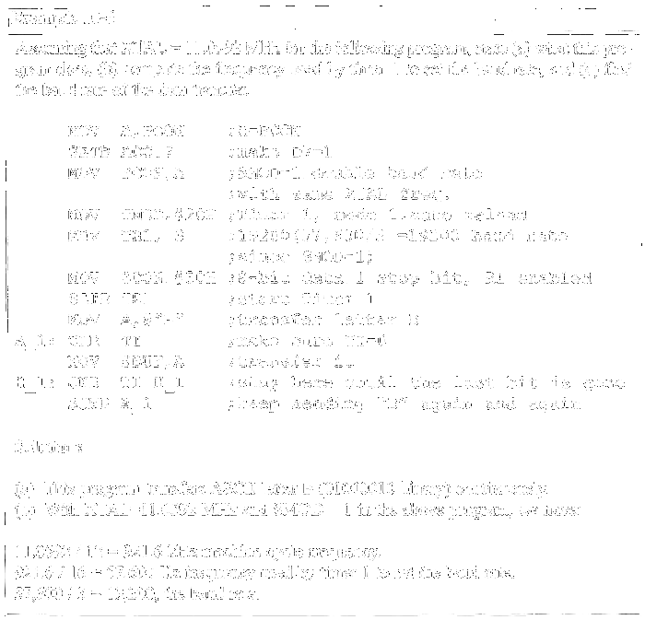

Slide 28
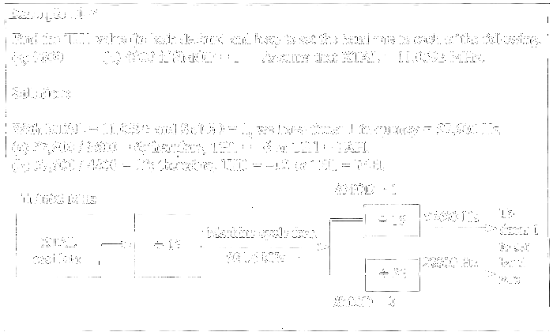

Slide 29
